Slide 1
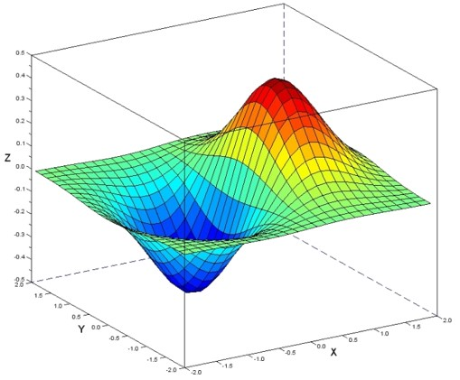
Calculus
Looking at functions in detail
Yordan Darakchiev
Technical Trainer
iordan93@gmail.com

Slide 2
sli.do #MathForDevs

Slide 3
Table of Contents
Limits
Derivatives
Integrals
Calculus in many dimensions
Gradient descent

Slide 4
Limits
Approaching places

Slide 5

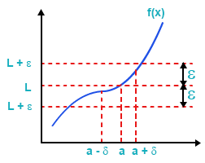


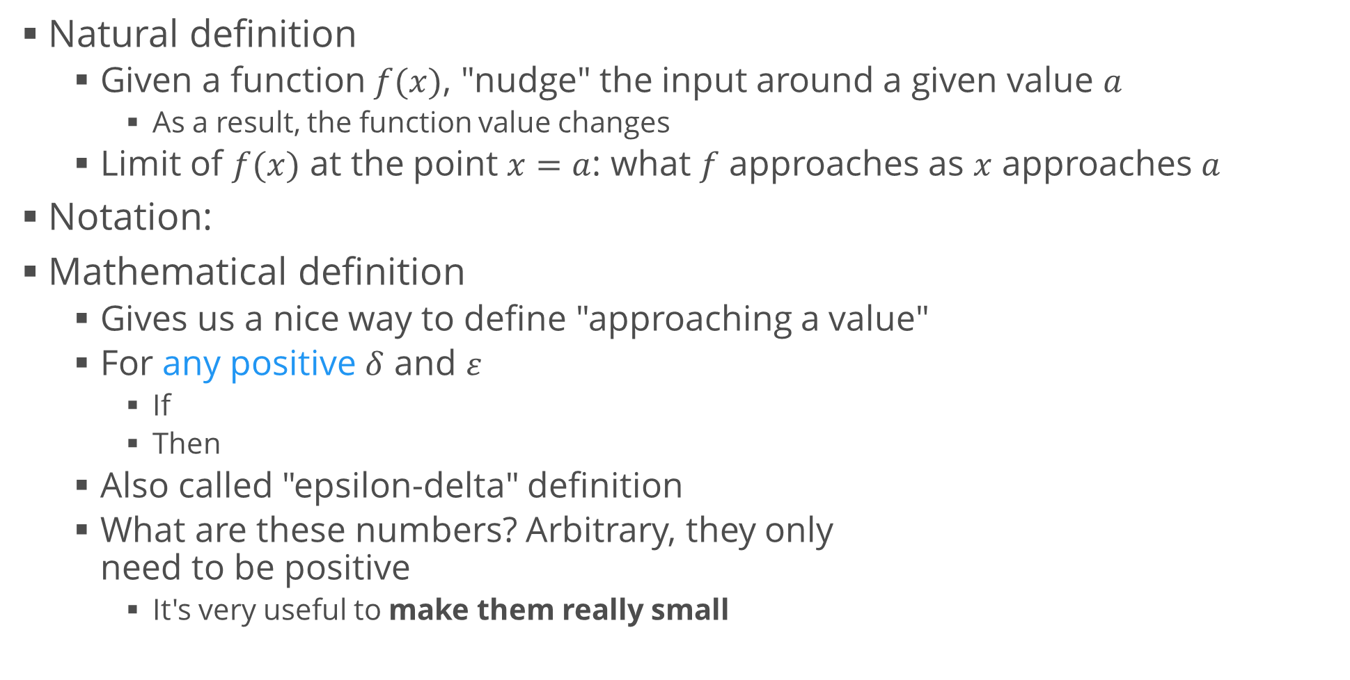
Limit
Natural definition
Given a function $f(x)$, "nudge" the input around a given value $a$
As a result, the function value changes
Limit of $f(x)$ at the point $x=a$: what $f$ approaches as $x$ approaches $a$
Notation:
Mathematical definition
Gives us a nice way to define "approaching a value"
For any positive $δ$ and $ε$
If
Then
Also called "epsilon-delta" definition
What are these numbers? Arbitrary, they only need to be positive
It's very useful to make them really small

Slide 6

Limits in Python
To find the limit of a function at a point, just apply the definition
Generate several values of $x$ around $a$
Don't forget to include positive and negative "nudges"
Print the function values at those points
def get_limit(f, a):
epsilon = np.array([
10 ** p
for p in np.arange(0, -11, -1, dtype = float)])
x = np.append(a - epsilon, (a + epsilon)[::-1])
y = f(x)
return y
print(get_limit(lambda x: x ** 2, 3)) print(get_limit(lambda x: x ** 2 + 3 * x, 2))
print(get_limit(lambda x: np.sin(x), 0))

Slide 7
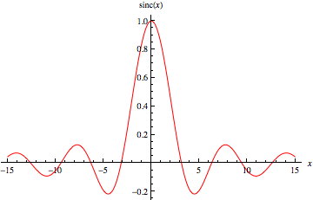
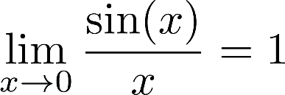

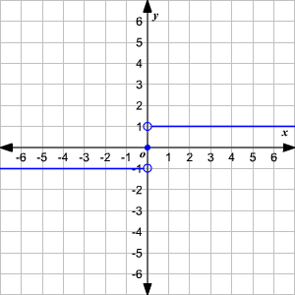
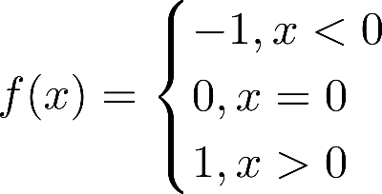

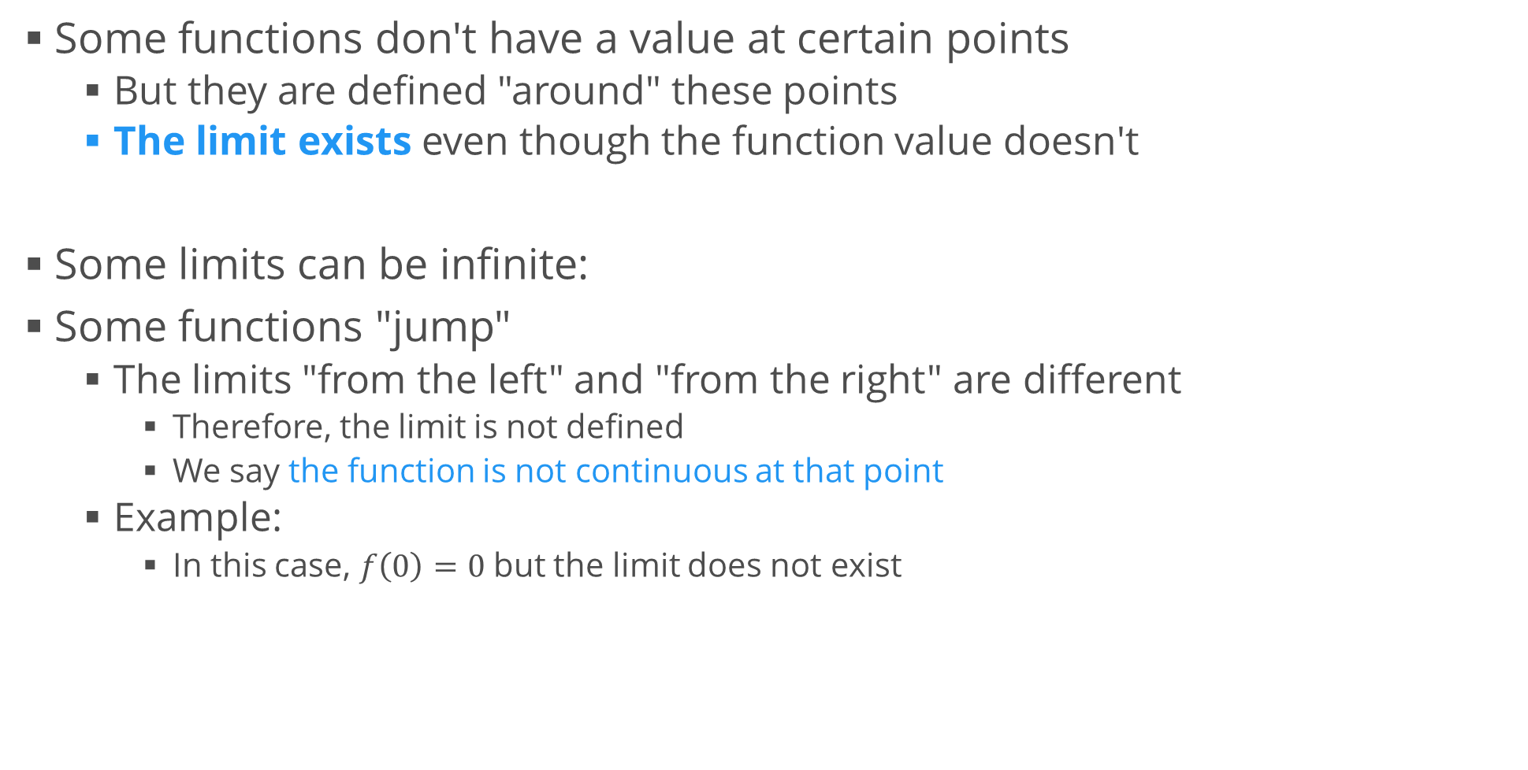
More Limits
Some functions don't have a value at certain points
But they are defined "around" these points
The limit exists even though the function value doesn't
Some limits can be infinite:
Some functions "jump"
The limits "from the left" and "from the right" are different
Therefore, the limit is not defined
We say the function is not continuous at that point
Example:
In this case, $f\left(0\right)=0$ but the limit does not exist

Slide 8
Derivatives
Slope and velocity

Slide 9
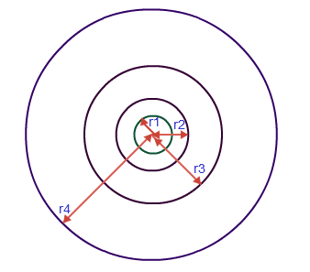



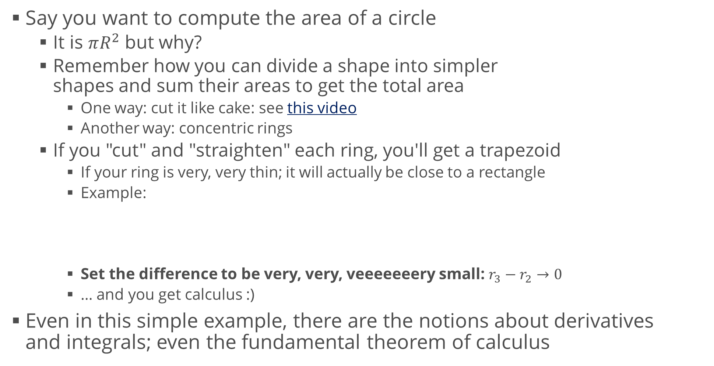
Calculus Motivation
Say you want to compute the area of a circle
It is $πR^{2}$ but why?
Remember how you can divide a shape into simpler shapes and sum their areas to get the total area
One way: cut it like cake: see this video
Another way: concentric rings
If you "cut" and "straighten" each ring, you'll get a trapezoid
If your ring is very, very thin; it will actually be close to a rectangle
Example:
Set the difference to be very, very, veeeeeeery small: $r_{3}−r_{2}→0$
… and you get calculus :)
Even in this simple example, there are the notions about derivatives and integrals; even the fundamental theorem of calculus

Slide 10
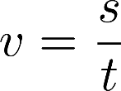
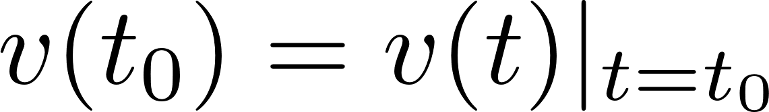
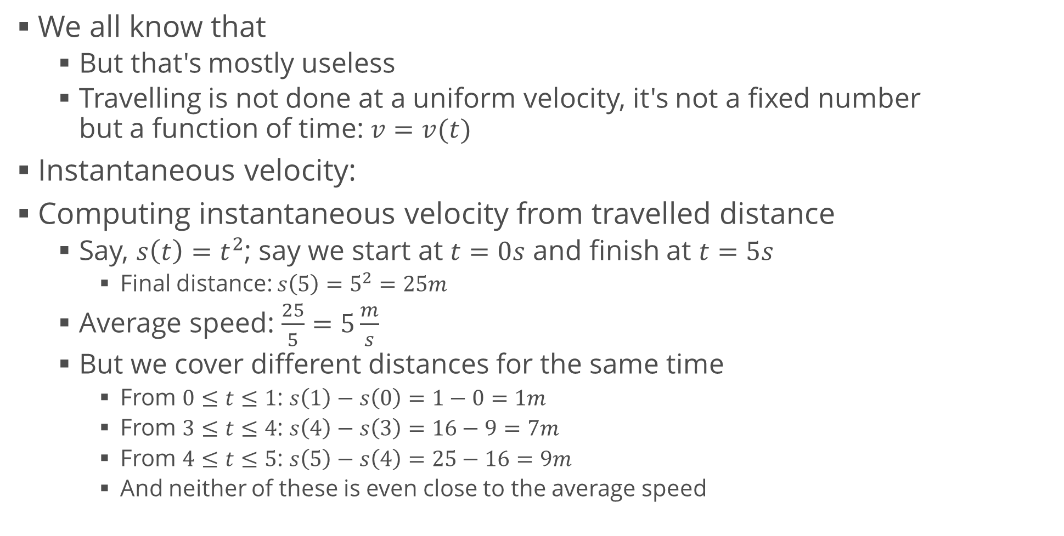
Derivatives and Velocity
We all know that
But that's mostly useless
Travelling is not done at a uniform velocity, it's not a fixed number but a function of time: $v=v(t)$
Instantaneous velocity:
Computing instantaneous velocity from travelled distance
Say, $s\left(t\right)=t^{2}$; say we start at $t=0s$ and finish at $t=5s$
Final distance: $s\left(5\right)=5^{2}=25m$
Average speed: $\frac{25}{5}=5\frac{m}{s}$
But we cover different distances for the same time
From $0≤t≤1$: $s\left(1\right)−s\left(0\right)=1−0=1m$
From $3≤t≤4$: $s\left(4\right)−s\left(3\right)=16−9=7m$
From $4≤t≤5$: $s\left(5\right)−s\left(4\right)=25−16=9m$
And neither of these is even close to the average speed

Slide 11
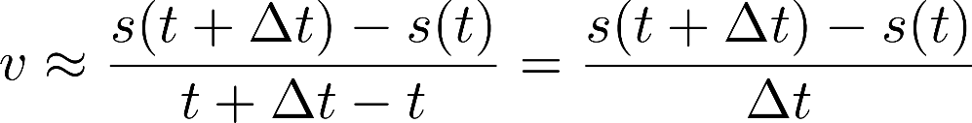
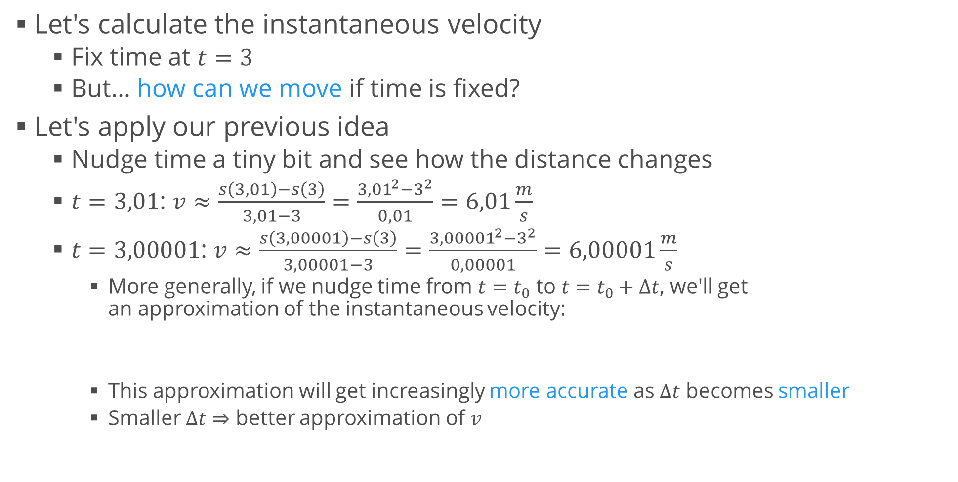
Derivatives and Velocity (2)
Let's calculate the instantaneous velocity
Fix time at $t=3$
But… how can we move if time is fixed?
Let's apply our previous idea
Nudge time a tiny bit and see how the distance changes
$t=3,01$: $v≈\frac{s\left(3,01\right)−s\left(3\right)}{3,01−3}=\frac{{3,01}^{2}−3^{2}}{0,01}=6,01\frac{m}{s}$
$t=3,00001$: $v≈\frac{s\left(3,00001\right)−s\left(3\right)}{3,00001−3}=\frac{{3,00001}^{2}−3^{2}}{0,00001}=6,00001\frac{m}{s}$
More generally, if we nudge time from $t=t_{0}$ to $t=t_{0}+Δt$, we'll get an approximation of the instantaneous velocity:
This approximation will get increasingly more accurate as $Δt$ becomes smaller
Smaller $Δt⇒$ better approximation of $v$

Slide 12
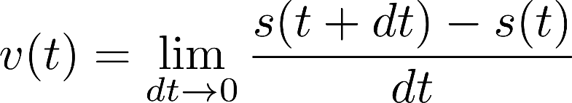
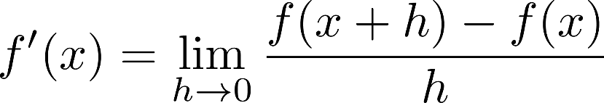
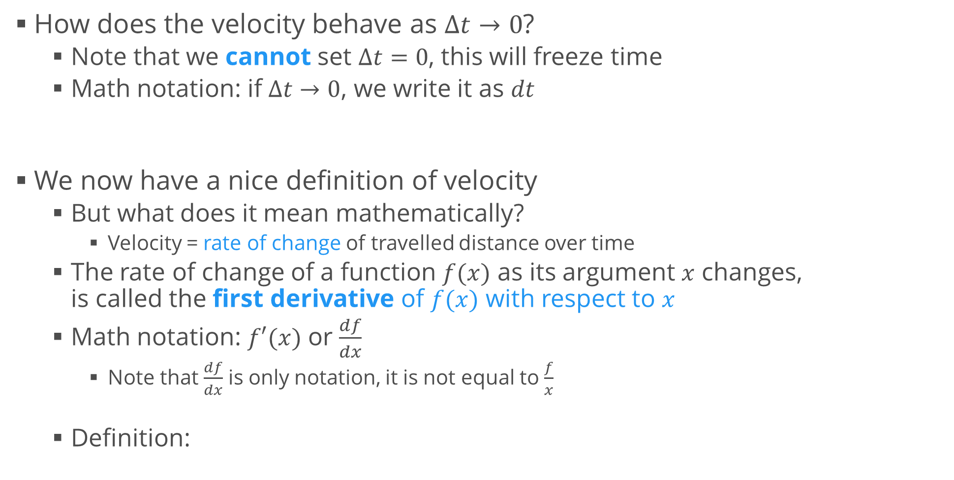
Derivatives and Velocity (3)
How does the velocity behave as $Δt→0$?
Note that we cannot set $Δt=0$, this will freeze time
Math notation: if $Δt→0$, we write it as $dt$
We now have a nice definition of velocity
But what does it mean mathematically?
Velocity = rate of change of travelled distance over time
The rate of change of a function $f(x)$ as its argument $x$ changes, is called the first derivative of $f(x)$ with respect to $x$
Math notation: $f′(x)$ or $\frac{df}{dx}$
Note that $\frac{df}{dx}$ is only notation, it is not equal to $\frac{f}{x}$
Definition:

Slide 13
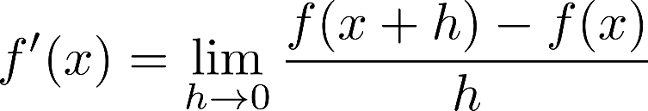
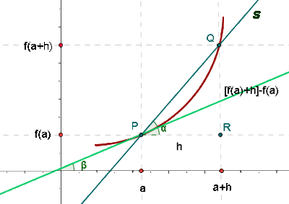
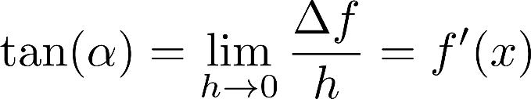
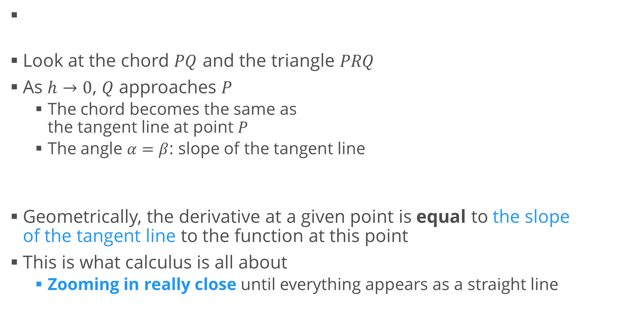
Geometric Interpretation
Look at the chord $PQ$ and the triangle $PRQ$
As $h→0$, $Q$ approaches $P$
The chord becomes the same as the tangent line at point $P$
The angle $α=β$: slope of the tangent line
Geometrically, the derivative at a given point is equal to the slope of the tangent line to the function at this point
This is what calculus is all about
Zooming in really close until everything appears as a straight line

Slide 14
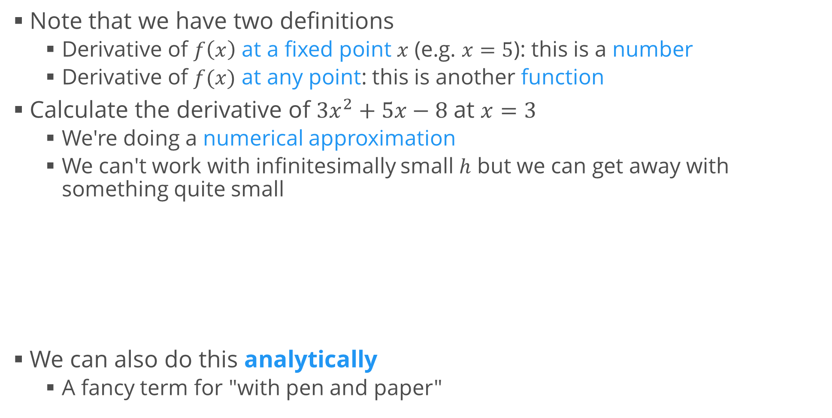
Calculating Derivatives
Note that we have two definitions
Derivative of $f\left(x\right)$ at a fixed point $x$ (e.g. $x=5$): this is a number
Derivative of $f(x)$ at any point: this is another function
Calculate the derivative of $3x^{2}+5x−8$ at $x=3$
We're doing a numerical approximation
We can't work with infinitesimally small $h$ but we can get away with something quite small
We can also do this analytically
A fancy term for "with pen and paper"
def calculate_derivative(f, a, h = 1e-7):
return (f(a + h) - f(a)) / h
print(calculate_derivative(lambda x: 3 * x**2 + 5 * x - 8, 3))
# 23.00000026878024

Slide 15
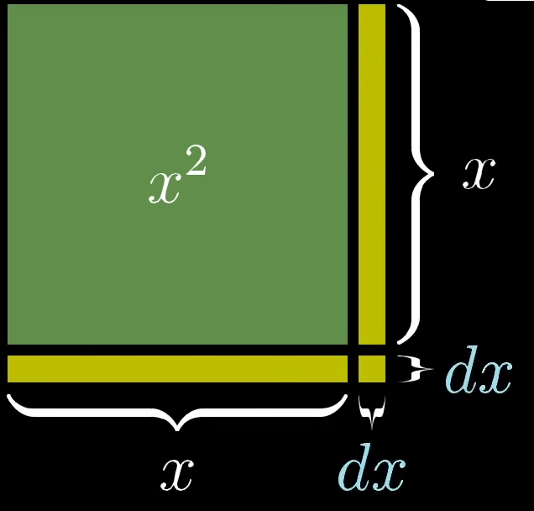
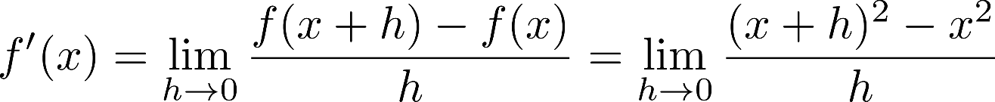
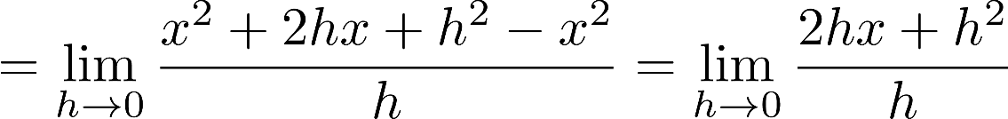
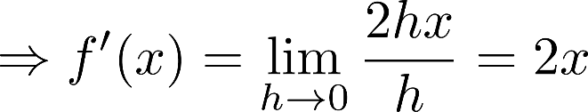
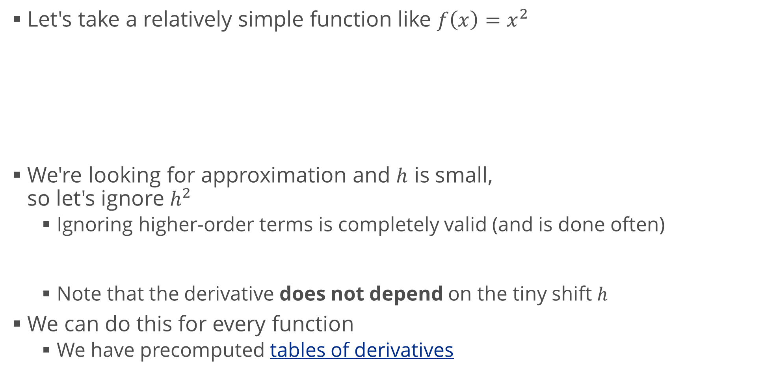
Calculating Derivatives Analytically
Let's take a relatively simple function like $f\left(x\right)=x^{2}$
We're looking for approximation and $h$ is small, so let's ignore $h^{2}$
Ignoring higher-order terms is completely valid (and is done often)
Note that the derivative does not depend on the tiny shift $h$
We can do this for every function
We have precomputed tables of derivatives

Slide 16
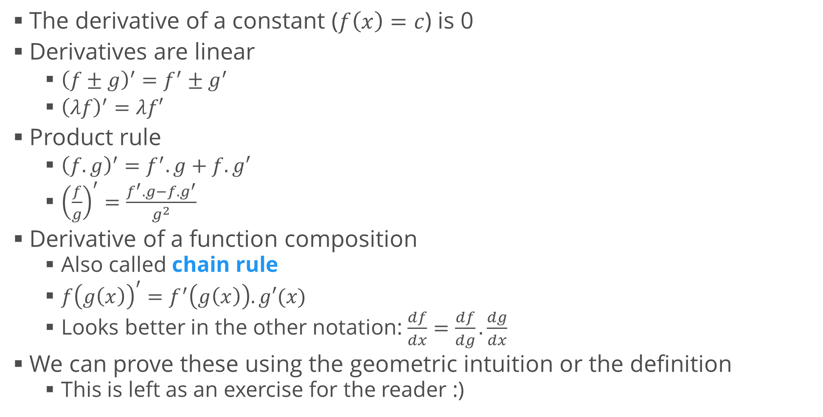
Properties of Derivatives
The derivative of a constant ($f\left(x\right)=c$) is 0
Derivatives are linear
${\left(f±g\right)}^{′}=f^{′}±g^{′}$
${\left(λf\right)}^{′}=λf′$
Product rule
${\left(f.g\right)}^{′}=f^{′}.g+f.g′$
${\left(\frac{f}{g}\right)}^{′}=\frac{f^{′}.g−f.g^{′}}{g^{2}}$
Derivative of a function composition
Also called chain rule
$f{\left(g\left(x\right)\right)}^{′}=f^{′}\left(g\left(x\right)\right).g′(x)$
Looks better in the other notation: $\frac{df}{dx}=\frac{df}{dg}.\frac{dg}{dx}$
We can prove these using the geometric intuition or the definition
This is left as an exercise for the reader :)

Slide 17
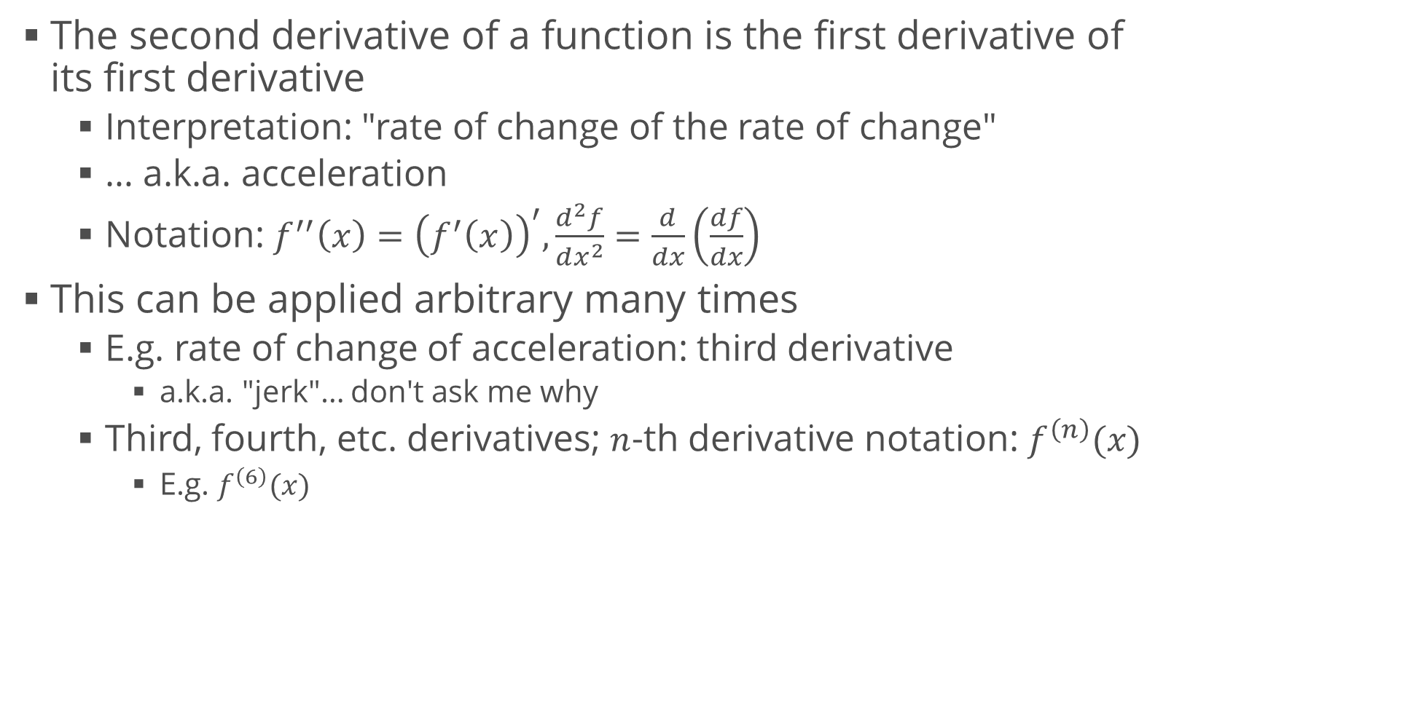
Higher-Order Derivatives
The second derivative of a function is the first derivative of its first derivative
Interpretation: "rate of change of the rate of change"
… a.k.a. acceleration
Notation: $f^{′′}\left(x\right)={\left(f^{′}\left(x\right)\right)}^{′},\frac{d^{2}f}{dx^{2}}=\frac{d}{dx}\left(\frac{df}{dx}\right)$
This can be applied arbitrary many times
E.g. rate of change of acceleration: third derivative
a.k.a. "jerk"… don't ask me why
Third, fourth, etc. derivatives; $n$-th derivative notation: $f^{\left(n\right)}(x)$
E.g. $f^{\left(6\right)}(x)$

Slide 18
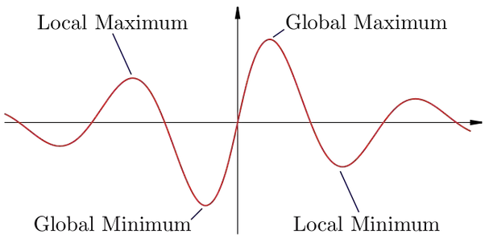
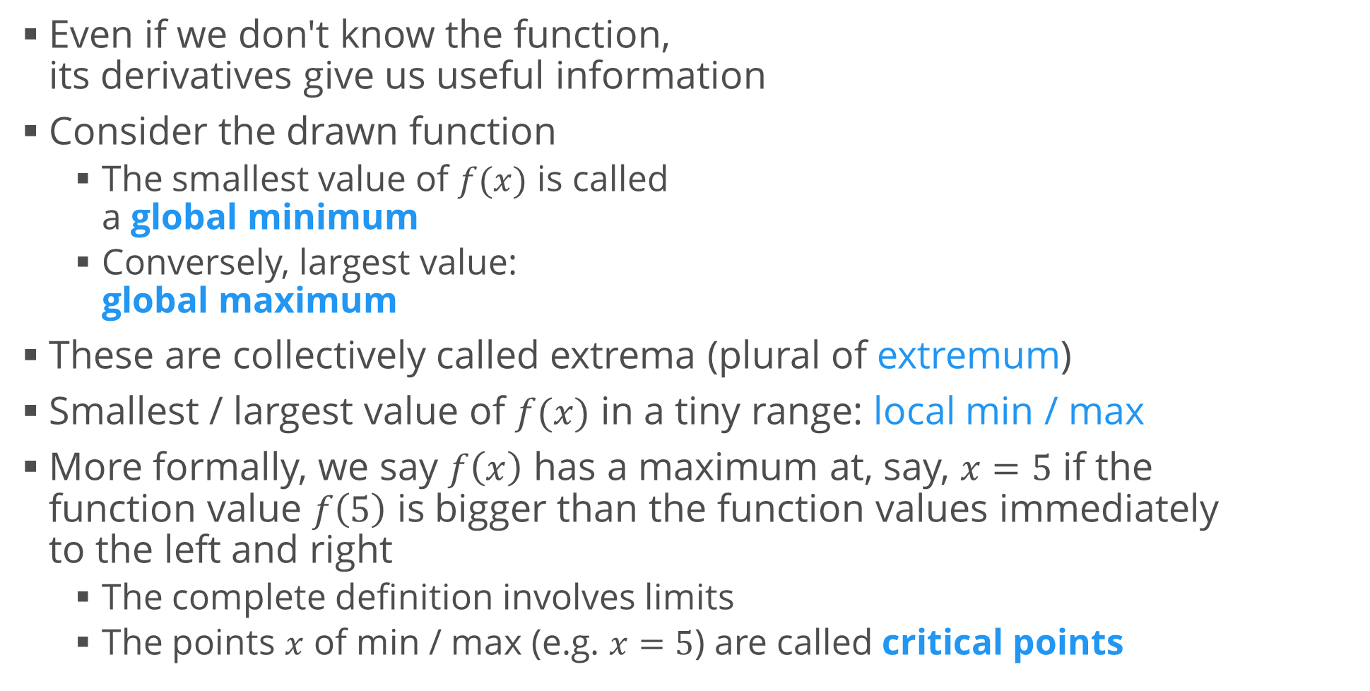
Function Extrema
Even if we don't know the function, its derivatives give us useful information
Consider the drawn function
The smallest value of $f(x)$ is called a global minimum
Conversely, largest value: global maximum
These are collectively called extrema (plural of extremum)
Smallest / largest value of $f(x)$ in a tiny range: local min / max
More formally, we say $f\left(x\right)$ has a maximum at, say, $x=5$ if the function value $f\left(5\right)$ is bigger than the function values immediately to the left and right
The complete definition involves limits
The points $x$ of min / max (e.g. $x=5$) are called critical points

Slide 19
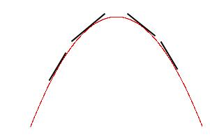
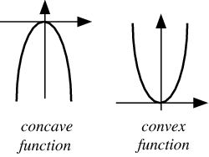
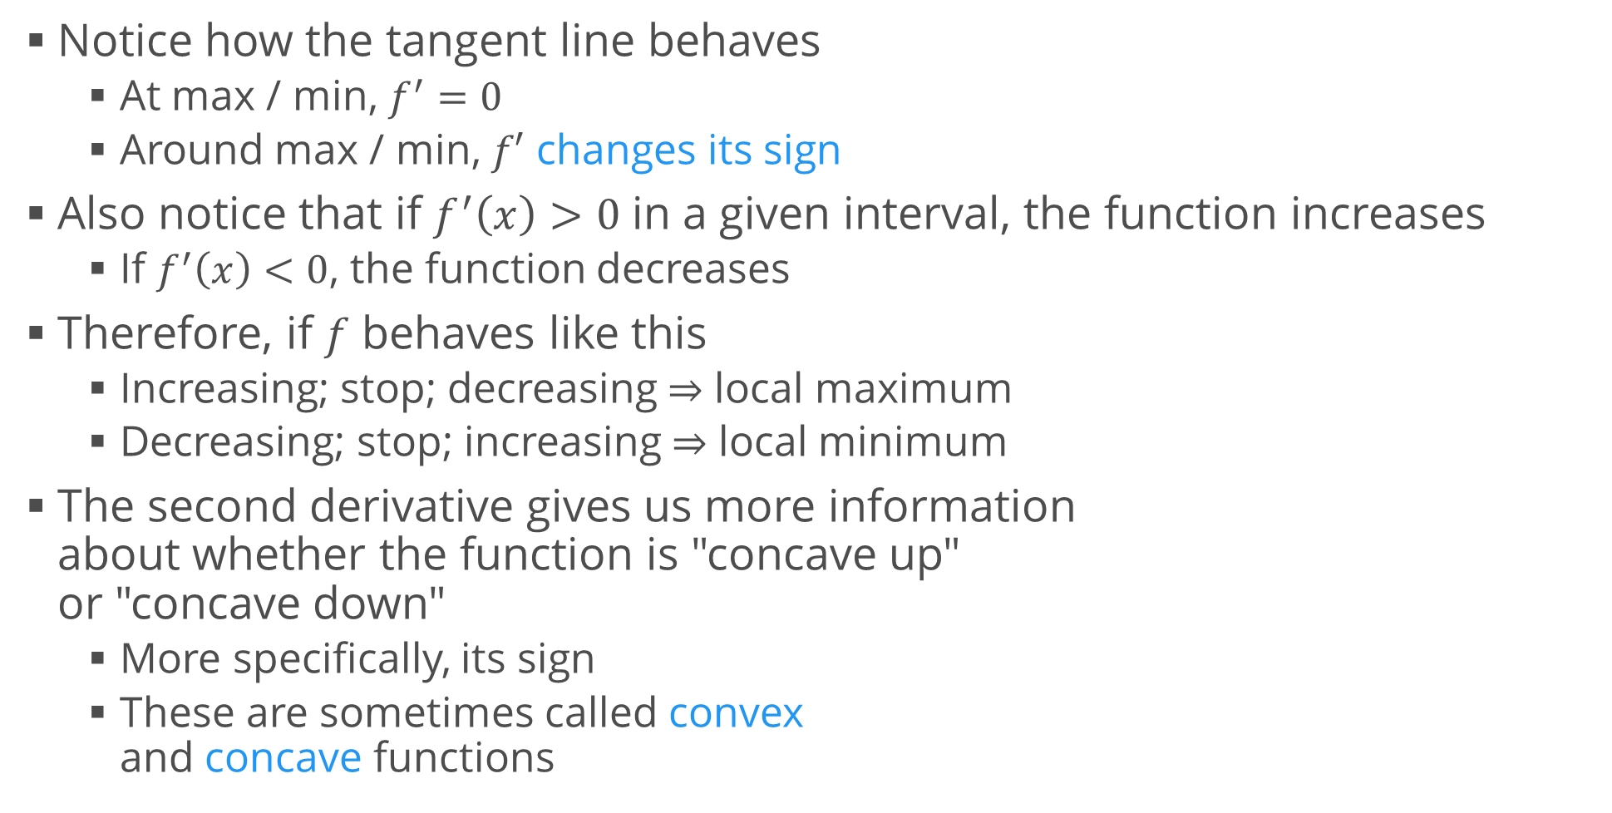
Function Extrema (2)
Notice how the tangent line behaves
At max / min, $f^{′}=0$
Around max / min, $f′$ changes its sign
Also notice that if $f^{′}\left(x\right)>0$ in a given interval, the function increases
If $f^{′}\left(x\right)<0$, the function decreases
Therefore, if $f$ behaves like this
Increasing; stop; decreasing $⇒$ local maximum
Decreasing; stop; increasing $⇒$ local minimum
The second derivative gives us more information about whether the function is "concave up" or "concave down"
More specifically, its sign
These are sometimes called convex and concave functions

Slide 20
Integrals
Areas and accumulation

Slide 21
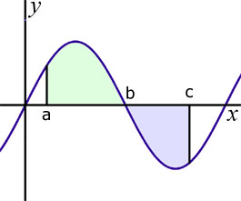
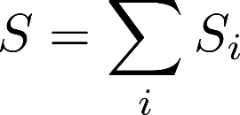
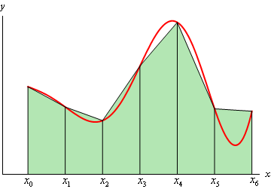

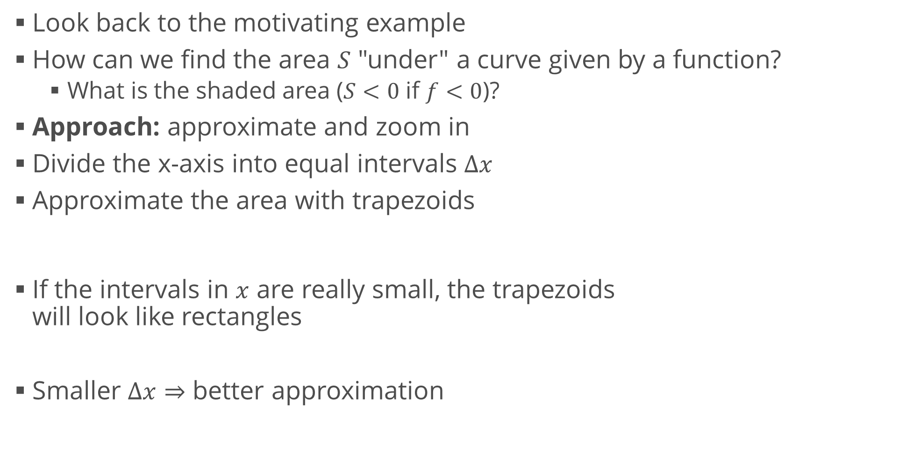
Area under a Function
Look back to the motivating example
How can we find the area $S$ "under" a curve given by a function?
What is the shaded area ($S<0$ if $f<0$)?
Approach: approximate and zoom in
Divide the x-axis into equal intervals $Δx$
Approximate the area with trapezoids
If the intervals in $x$ are really small, the trapezoids will look like rectangles
Smaller $Δx⇒$ better approximation

Slide 22
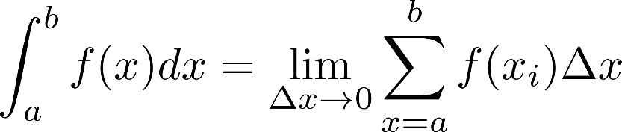
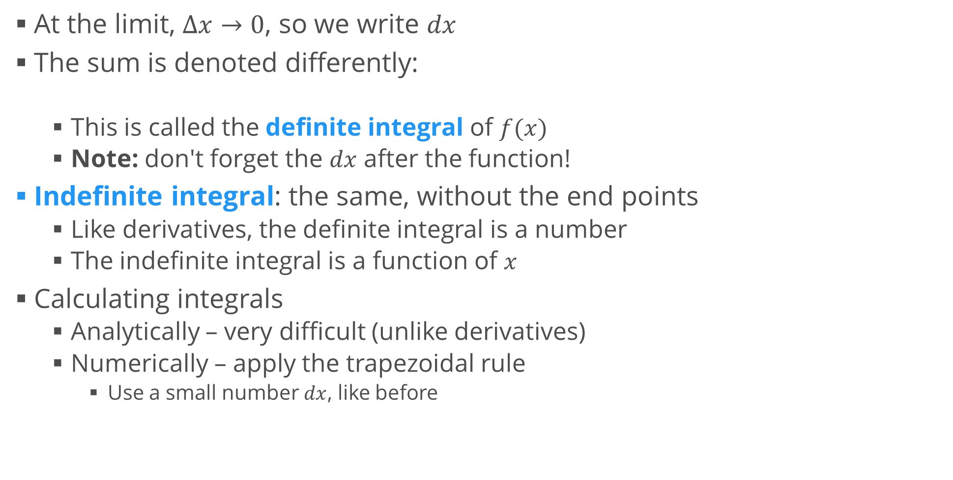
Integral of a Function
At the limit, $Δx→0$, so we write $dx$
The sum is denoted differently:
This is called the definite integral of $f(x)$
Note: don't forget the $dx$ after the function!
Indefinite integral: the same, without the end points
Like derivatives, the definite integral is a number
The indefinite integral is a function of $x$
Calculating integrals
Analytically – very difficult (unlike derivatives)
Numerically – apply the trapezoidal rule
Use a small number $dx$, like before

Slide 23
Fundamental Theorem of Calculus
Putting it all together

Slide 24
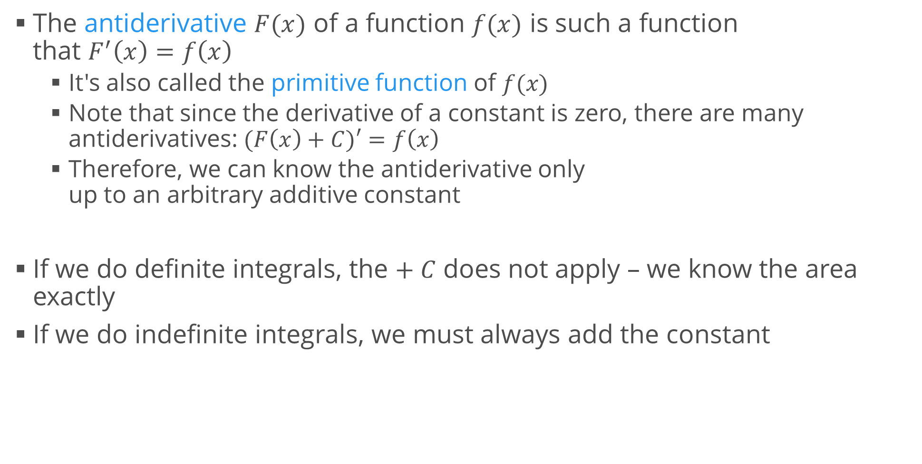
Antiderivatives
The antiderivative $F(x)$ of a function $f(x)$ is such a function that $F^{′}\left(x\right)=f\left(x\right)$
It's also called the primitive function of $f(x)$
Note that since the derivative of a constant is zero, there are many antiderivatives: $(F\left(x\right)+C)′=f\left(x\right)$
Therefore, we can know the antiderivative only up to an arbitrary additive constant
If we do definite integrals, the $+ C$ does not apply – we know the area exactly
If we do indefinite integrals, we must always add the constant

Slide 25
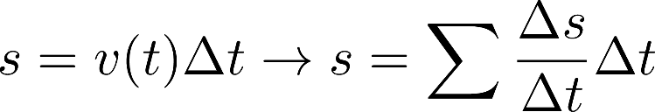
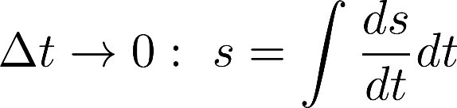
Fundamental Theorem of Calculus
The indefinite integral of a function is related to its antiderivative and can be reversed via differentiation
The definite integral of a function can be computed using one of its infinitely many antiderivatives
Simply, differentiation and integration are inverse functions
Proof: Khan Academy
Intuition
The sum of infinitesimal changes in a quantity over time adds up to the net change in quantity
Think about distance and velocity again

Slide 26
Calculus in Many Dimensions
Same thing, a little different notation

Slide 27
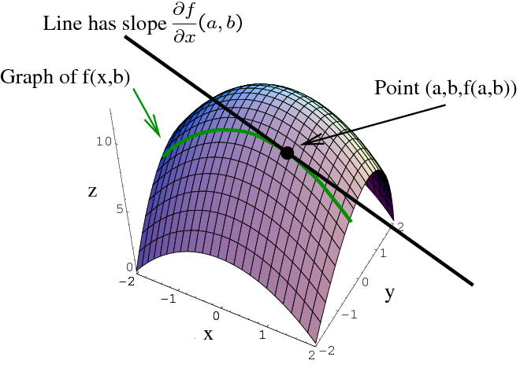
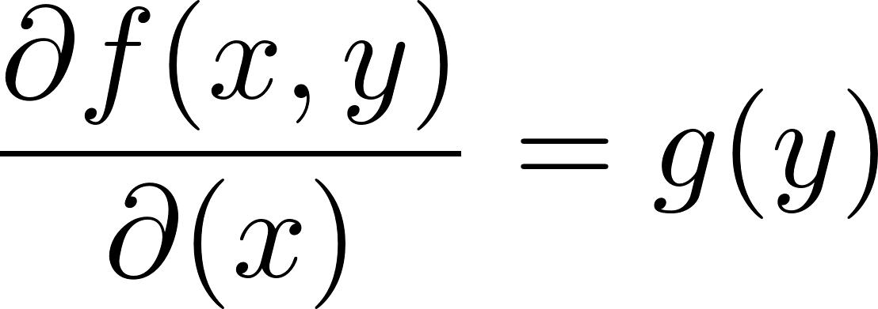
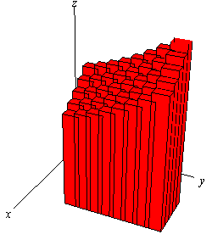
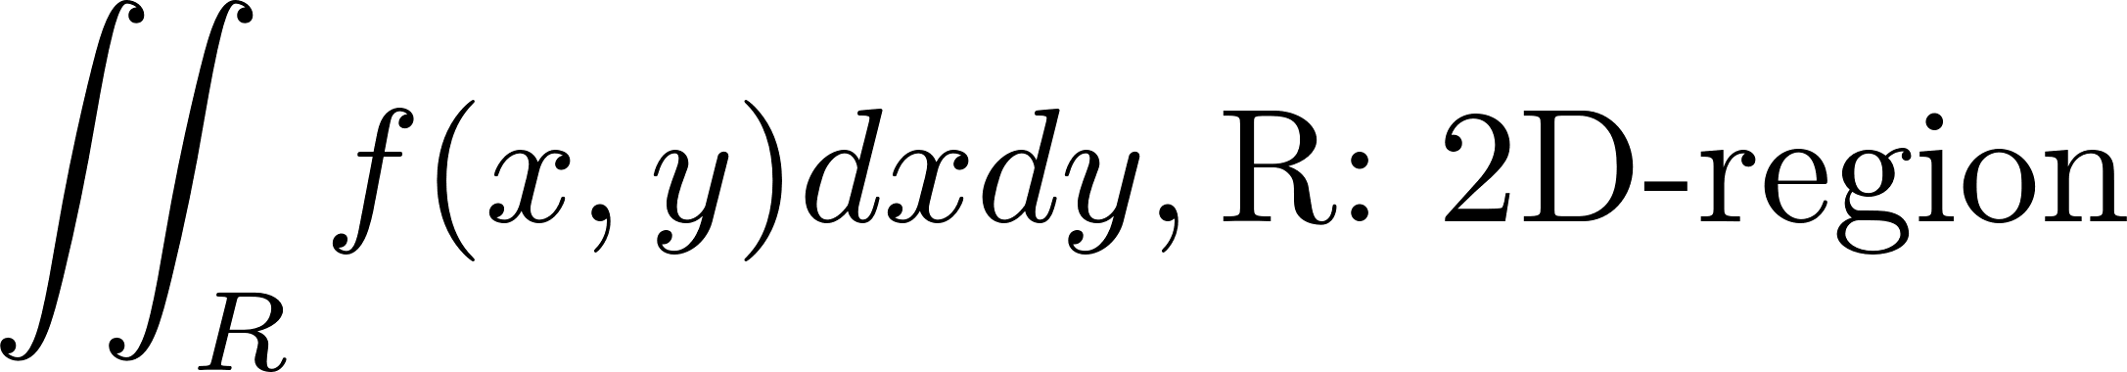

Generalizations
The notions of derivatives and integrals generalize to more dimensions
Derivatives: take the derivative w.r.t. one variable, treat the other variables as "parameters" $→$ partial derivatives
Yet more confusing notation: $∂$ is the same as $d$, it's just used for many dimensions
Integrals: 1D intervals $[a; b]$ can become curves or planes
Apply the same "zooming in" technique

Slide 28


Gradient Descent
Optimization method
Used for finding local extrema
Gradient: $grad(f)$ or $∇f$
A combination of vector and derivative:
"Multi-dimensional derivative"
A vector whose components are the partial derivatives w.r.t. every variable
Shows where the steepest rise in slope is
If we follow the gradient, we'll arrive at a maximum
Conversely, negative gradient takes us to a minimum
Iterative procedure
Continue to apply until close enough
Not guaranteed to find global extrema
May get "stuck" in a local extremum

Slide 29


Example: Gradient Descent
Find a local minimum of the function
Start at $x = 6$
x_old = 0
x_new = 6
step_size = 0.01
precision = 0.00001
def df(x):
# f'(x^4 - 3x^3 + 2) = 4x^3 - 9x^2
y = 4 * x ** 3 - 9 * x ** 2
return y
while abs(x_new - x_old) > precision:
x_old = x_new
x_new += -step_size * df(x_old)
print("The local minimum occurs at ", x_new)

Slide 30
Summary
Limits
Derivatives
Integrals
Calculus in many dimensions
Gradient descent

